Slide 1
Application Security Project
Cybernetic
Group: Joel (Leader), William, Dylan, Kent

Slide 2
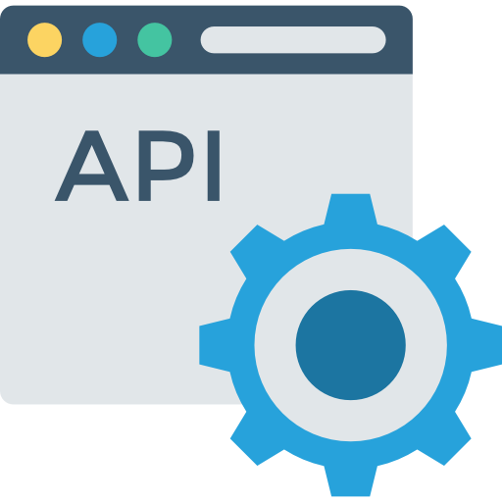
Introduction
Cybernetic
Web APIs used for e-commerce web application
It is first implemented as insecure version and further improved as secure version
Insecure Version | Secure Version
Insecure with OWASP API Security Top 10 Vulnerability | Secure with Security Fixes Implemented
No input validation | (The Top 10 Proactive Control) C5: All input validation
Not All Errors and Exceptions Handled | C10: Handle All Errors and Exceptions
Security Frameworks and Libraries partially Leveraged. | C2: Leverage Security Frameworks and Libraries
 | C3: Secure Database Access

Slide 3
Platform Used
Programming Language Python Database Used MySQL
Security Testing tool Bandit (SAST) OWASP ZAP (DAST)
Development Framework Flask Flask-RESTX
Cloud Service Provider Amazon web service (AWS)
DevSecOps Github
SIEM
AlienVault OSSIM

Slide 4
API 1
Broken Object level Authorization
By: Joel

Slide 5
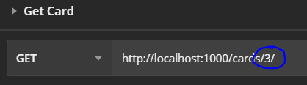
Vulnerability
APIs which are vulnerable to this can be exploited by manipulating the ID of an object that is sent within the request which may lead to unauthorized access to sensitive data.
Scenario : The attacker can change the id to access other users object

Slide 6
Fixes
JWT Token Authorization with Object’s Foreign Key :
User ID references User(User_ID)

Slide 7
API 2
Broken User Authentication
By: Joel

Slide 8
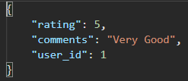
Vulnerability
This vulnerability is when authentication is not implemented properly which can be used by an attacker to compromise authentication tokens or assume the identity of another user.
Scenario : The attacker can impersonate another user by changing user ID

Slide 9
Fixes
JWT Token Authentication
Email Verification
Optional Multi Factor Authentication

Slide 10
API 3
Excessive Data Exposure
By : Dylan

Slide 11
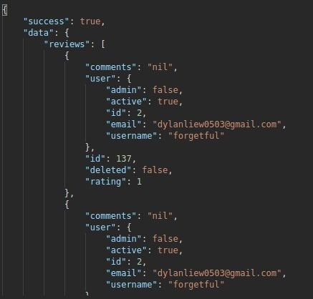
Vulnerability
Exploitation of Excessive Data Exposure is performed by sniffing the traffic to analyze the API responses, looking for sensitive data that should not be returned to the user.
Scenario : The attackers sniff the traffic of the product reviews response which return user sensitive information such as email

Slide 12
Fixes
Filter Data on Server Site
Censor parts of sensitive information
E.G. Phone Number : ******34
AWS Symmetric Key Encryption on database stored data at rest with AWS KMS for key management

Slide 13
API 5
Broken Function Level Authorization
By : Dylan

Slide 14
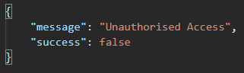
Vulnerability
Attackers can exploit APIs by sending legitimate API calls to API endpoints which the attacker should not have access to such as View All Users.
Scenario : The attacker sends a GET request to retrieve all users without authentication/user function level authorization which lead to expose of sensitive information of users

Slide 15
Fixes
Use of JWT Token to authenticate user identity which
then validate for user function level

Slide 16
API 6
Mass Assignment
By: Kent

Slide 17
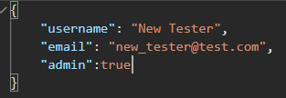
Vulnerability
This vulnerability occurs when multiple objects/entities of the same class have a common attribute that is assigned across these objects.
Scenario : The user edit the request such that he/she can modify admin attribute of himself/herself

Slide 18
Fixes
Whitelist attributes that can edited
Blacklist attributes that should not be edited
Sanitize user input

Slide 19
API 8
Injection
By : Kent

Slide 20
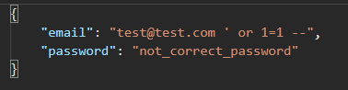
Vulnerability
This vulnerability occurs when an attacker supplied malicious input to the API which is processed by the interpreter, resulting in a change of the execution of the API.
Scenario : The attacker enter input that contains SQL query into the username/password field to bypass login authentication

Slide 21
Fixes
Use secure query functions
Sanitize user inputs

Slide 22
API 4
Lack of Resources & Rate Limiting
By: William

Slide 23
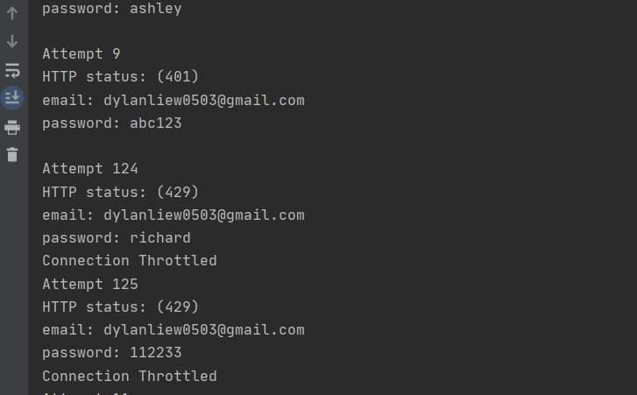
Vulnerability
The API is not protected against an excessive amount of API calls or payload sizes which can be use for Denial of Service (DoS) and authentication flaws such as brute force attacks.
Scenario : The attacker can brute force login system

Slide 24
Fixes
Pagination
Amazon API Gateway

Slide 25
API 10
Insufficient Logging &
Monitoring
By: William

Slide 26
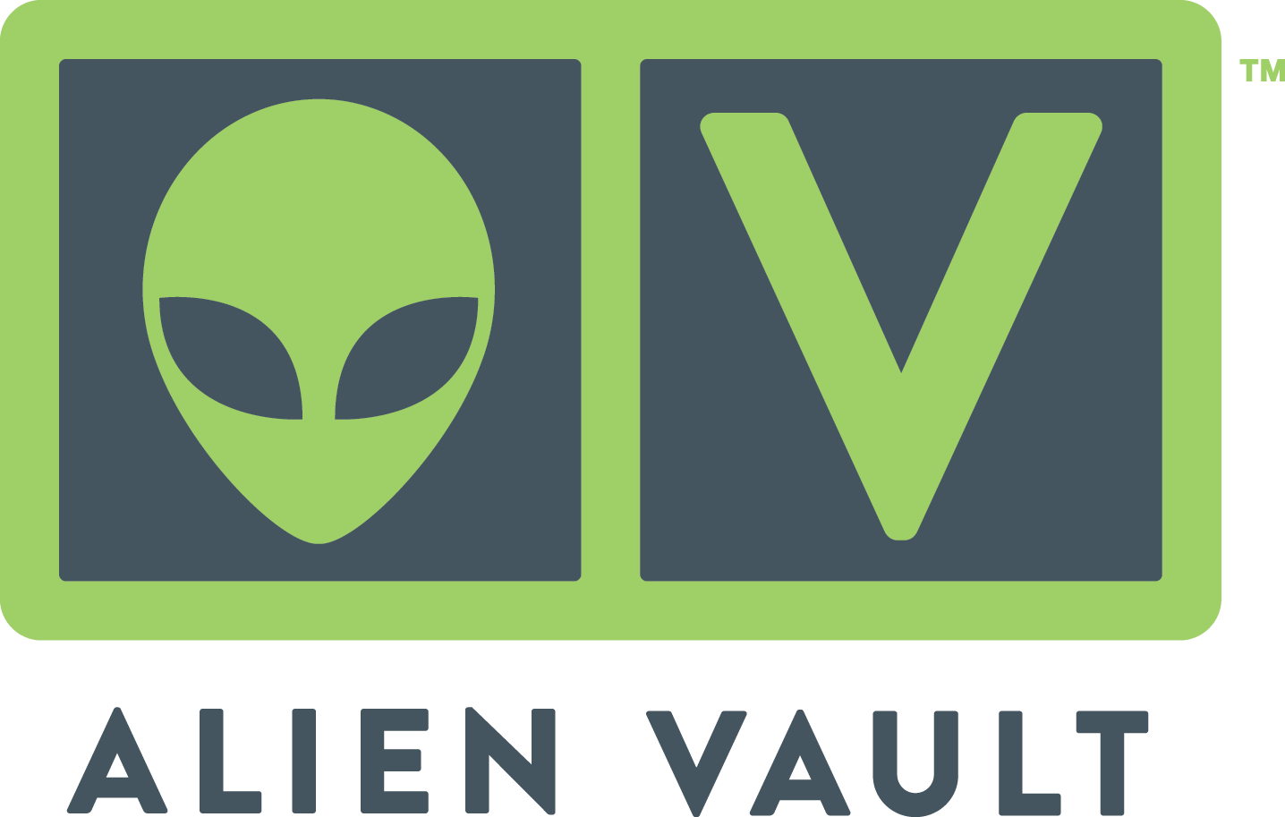
Vulnerability
Insufficient logging and monitoring allows attacker to abuse systems without being noticed.
Scenario :
Due to insufficient logging, the company is not able to assess what data was accessed by malicious actors.

Slide 27
Fixes
AlienVault OSSIM

Slide 28
API 7
Security Misconfiguration
By: william

Slide 29
Vulnerability
Misconfigured systems allow attackers to gain unauthorized access or knowledge of the system.

Slide 30
Fixes
Usage of AWS Secret Manager of manager secrets
Secure Random Generator
X-Frame-Options header set to "Sameorigin" to prevent clickjacking attacks
X-Content-Type-Options set to "nosniff" to protect against MIME sniffing vulnerabilities
Use of Secure Hash Functions

Slide 31
Testing
SAST & DAST

Slide 32
SAST
Bandit
Use of GitHub Actions to perform Bandit Testing
Insecure Version | Secure Version
Use of insecure MD2, MD4, MD5, or SHA1 hash function | Solved by using Bcrypt
Standard pseudo-random generators are not suitable for security/cryptographic purposes. | Solved by using Cryptographically Secure Pseudo-Random Number Generator
Possible Hardcoded Password | Solved by using AWS Secret Manager
Possible SQL injection vector through string-based query construction. | Solved by using SQLAlchemy Functions

Slide 33
DAST
OWASP ZAP
Use of Postman JSON File which is then converted to OpenApi 3.0 (Json)
For OWASP Zap to do automatic scan
Insecure Version | Secure Version
SQL Injection | Solved by using SQLAlchemy Functions
Buffer Overflow | Solved by turning off the debugger ( Not Considered as a vulnerability )
X-Frame-Options Header Not Set | X-Frame-Options header set to "Sameorigin" to prevent clickjacking attacks
X-Content-Type-Options Header Missing | X-Content-Type-Options set to "nosniff" to protect against MIME sniffing vulnerabilities
Absence of Anti-CSRF Tokens | Solved by turning off the debugger ( Not Considered as a vulnerability )
Cross Site Scripting | Solved by using Marshmallow to ensure it’s treated as a string instead of script

Slide 34
DAST
Insecure Version | Secure Version
Application Error Disclosure | Solved by turning off the debugger
Information Disclosure - Sensitive Information in URL | Not Considered as a vulnerability
Timestamp Disclosure - Unix | Remove timestamp
Information Disclosure - Suspicious Comments | Solved by turning off the debugger

Slide 35
THANKS

